Slide 1
NPI& Strategy Production

Slide 2
NPI Process
1.如試產Pass可以直接進入NPI量產,需要召開NPI會議,check相關文件部份是否DCC,并匯總成會議記錄
2.如試產Fail,需要再做一次DVT/PVT試產,解決問題,如果客戶需求急,就安排策生量產,
2. If pilot run is fail, need to do DVT/PVT again to fix the problem.
But if customer has production demand, Sales will issue strategy production
-----TW Sales
1. After pilot run is pass, the project will goes to NPI--- TW PM

Slide 3
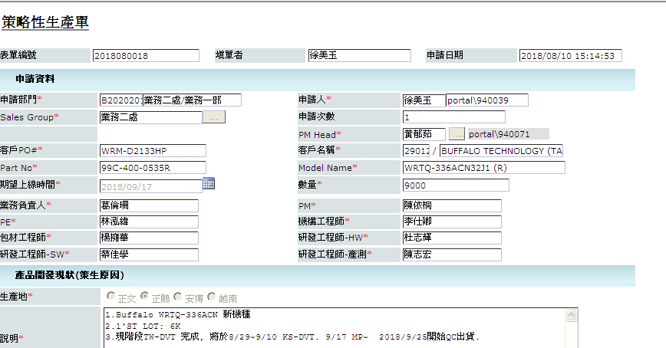
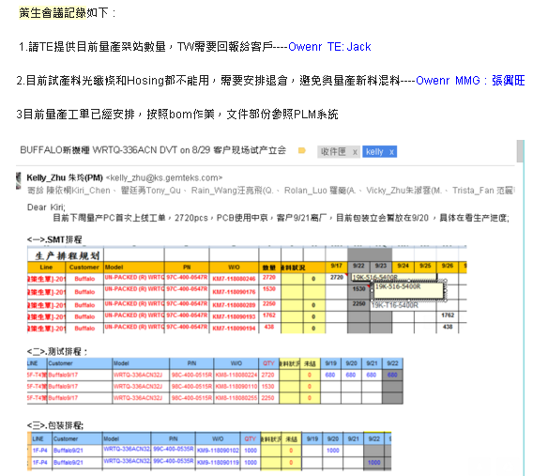
2-1 Strategy Production
2-1 TW業務開立策生單(例:2018080018),根據策生單內容安排生產,PM召開策生會議,討論策生上線注意點,并依郵件的形式告知相關人員
2-1 Sales will issue application in Portal, PM attend the meeting to collect info of this strategy production and email to related department

Slide 4
2-2,2-3 Strategy Production
2-2.PC根據策生單開立工單并安排排程,採依據需求安排備料, 依據Bom作業,并在上線前齊料
2-2.PC issue WO and arrange the on line date and arrange the material
2-3.策生量產時,要確認良率是否達標,并追蹤試產問題點是否有解決.用一筆工單的良率作為依據,如果良率達標,試產的問題點都解決，策生量產為PASS,就可以召開NPI會議,導入NPI,匯總成會議記錄
2-3 Use one WO to check the yield and open issue, if pass, hold the NPI meeting

Slide 5
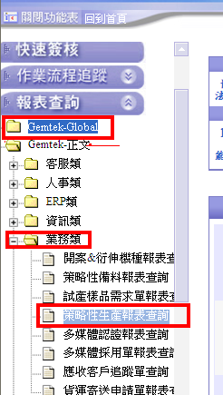
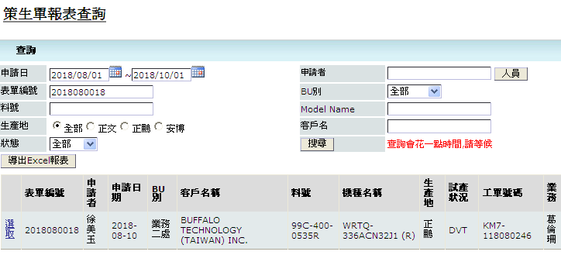
Reference
4.策生單查詢：
登陸”BPM Portal”,選擇Gemtek-Global→Gemtek-正文 →業務類→策略性生產報表查詢,出現介面后,輸入單號（2018080018),點擊:選取”,打開之後就可以看到策生單的內容

